Slide 1
Challenges of communicating COVID-19 statistics
RSS Conference Plenary Session
Anthony B. Masters
Statistical Ambassador
6th September 2021

Slide 2
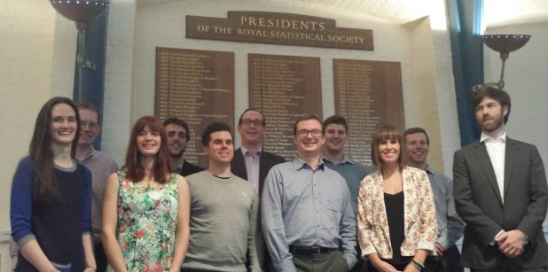

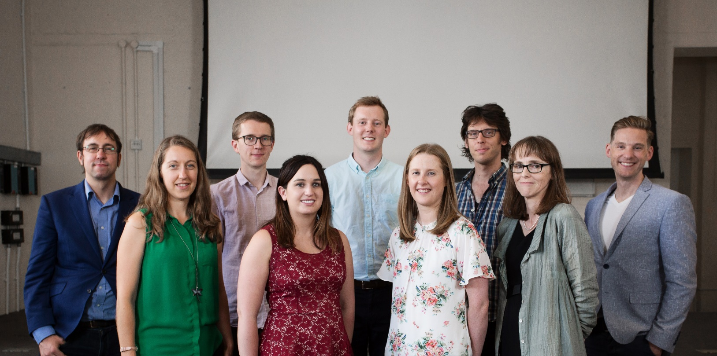
What is a Statistical Ambassador?
A Statistical Ambassador is a voluntary role for the Royal Statistical Society.
A misunderstood statistic can have dire consequences. We aim to improve public understanding of statistics. We work with policy-makers, researchers, journalists, and the public.

Slide 3
There are major challenges in communicating COVID-19 statistics.
Challenge I: Novel virus, novel statistics
Challenge II: Setting numbers in context
Challenge III: Limited space for explanations

Slide 4
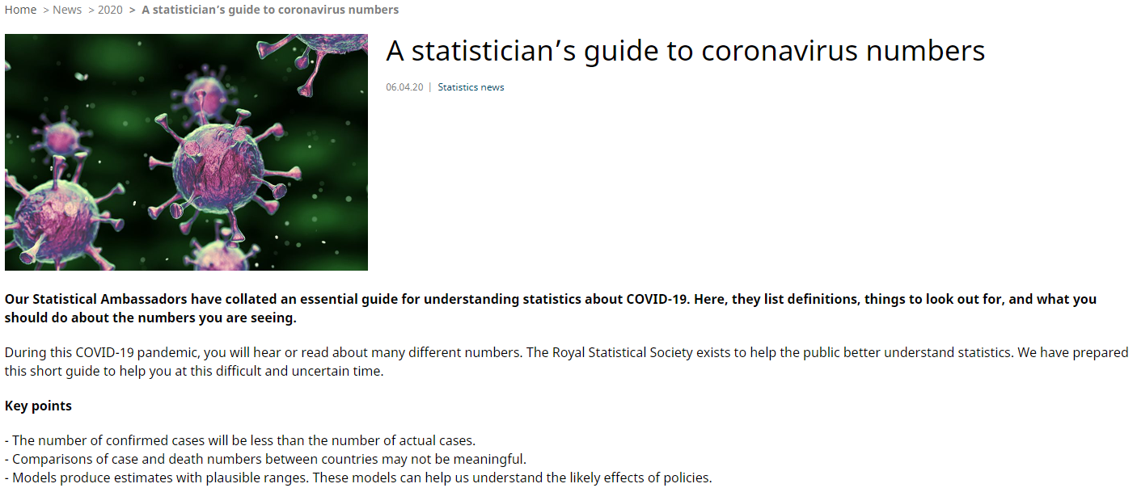
Ambassadors’ Guide to Coronavirus Numbers
With my fellow Statistical Ambassadors, we wrote a guide to COVID-19 statistics, to aid interpretation and understanding.

Slide 5
Posting on Medium
I maintain a regular Medium blog on statistical topics.
Here are some popular posts:
Title
Purpose
Deaths per Day Worldwide (17th July 2020)
A graph circulating on social media suggested there were only 56 Covid-19 deaths per day. The source is unclear and the stat appears out-of-date.
UK Polling on Black Lives Matter (15th September 2020)
A newspaper columnist asserted there were “no opinion polls available”. That was a false claim: I found UK (or GB) polls about Black Lives Matter.
Vaccine Efficacy Estimates
(28th November 2020)
News reports say that vaccines offer ‘95% protection’. The article looks at what those claims mean, and how to estimate uncertainty.
There were over 600,000 death registrations in 2020 (16th February 2021)
An erroneous image on social media claims there were only ~562,000 registrations in England and Wales. I correct that false claim.

Slide 6
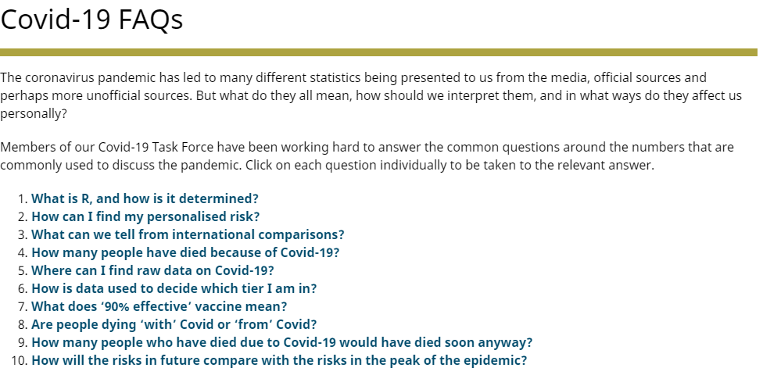
COVID-19 FAQs
I began a fruitful collaboration with Prof Sir David Spiegelhalter.
These FAQs covered key topics about COVID-19 statistics.

Slide 7
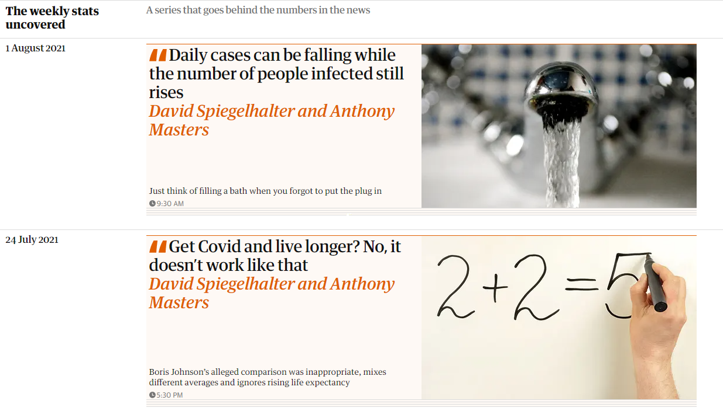
The Observer articles
Editors at the Sunday newspapers The Observer offered Sir David a column. As of 5th September 2021, this series has reached 34 articles. The rules are:
A limit of 350 words
No graphs or boxes
For the general public

Slide 8


Slide 9
References
The presentation format comes from the Royal Statistical Society.
The Covid-19 FAQs and A Statistician’s Guide to Coronavirus Numbers are on the RSS site.
My R code is on R Pubs and GitHub. I regularly update my Medium blog.
The ‘Weekly Stats Uncovered’ articles are on The Observer website and in the Sunday print edition.
Published by Penguin Random House, ‘Covid by Numbers’ is scheduled for publication on 30th September 2021. You can pre-order now.

